Slide 1
Data Cleaning
DATA COLLECTION AND DATA PROCESSING
“Obviously, the best way to treat missing data is not to have any.”
T. Orchard, M. Woodbury
“The most exciting phrase to hear, the one that heralds the most discoveries, is not “Eureka!” but “That's funny…”.”
I. Asimov

Slide 2
LEARNING OBJECTIVES
Recognize the strengths and weaknesses of both major data cleaning approaches
Identify methods to handle missing observations
Increase familiarity with various anomaly detection or outlier tests

Slide 3
Four VERY Important Remarks
NEVER work on the original dataset. Make copies along the way.
Document ALL your cleaning steps and procedures.
If you find yourself cleaning too much of your data, STOP. Something might be off with the data collection procedure.
Think TWICE before discarding an entire record.

Slide 4
Approaches to Data Cleaning
There are two philosophical approaches to data cleaning and validation:
methodical
narrative
The methodical approach consists of running through a check list of potential issues and flagging those that apply to the data.
The narrative approach consists of exploring the dataset and trying to spot unlikely and irregular patterns.

Slide 5
TAKE-AWAYS
The narrative approach is similar to working out a crossword puzzle with a pen and putting down potentially wrong answers every once in a while to see where that takes you.
The mechanical approach is similar to working it out with a pencil, a dictionary, and never jotting down an answer unless you are certain it is correct.
You’ll solve more puzzles (and it will be flashier) the first way, but you’ll rarely be wrong the second way.
Be comfortable with both approaches.

Slide 6
Types of Missing Observations
Blank fields come in 4 flavours:
Nonresponse an observation was expected but none had been entered
Data Entry Issue an observation was recorded but was not entered in the dataset
Invalid Entry an observation was recorded but was considered invalid and has been removed
Expected Blank a field has been left blank, but expectedly so

Slide 7
Types of Missing Observations
Too many missing values (of the first three type) can be indicative of issues with the data collection process (more on this later).
Too many missing values (of the fourth type) can be indicative of poor questionnaire design.

Slide 8
The Case for Imputation
Not all analytical methods can easily accommodate missing observations.
There are two options:
Discard the missing observation
not recommended, unless the data is missing completely randomly in the dataset as a whole
acceptable in certain situations (such as a small number of missing values in a large dataset)
Come up with a replacement value
main drawback: we never know for a fact what the true value would have been
often the best available option

Slide 9
Missing Mechanisms
Missing Completely at Random (MCAR)
item absence is independent of its value or of auxiliary variables
Missing at Random (MAR)
item absence is not completely random; can be accounted by auxiliary variables with complete info
Not Missing at Random (NMAR)
reason for nonresponse is related to item value (also called non-ignorable non-response)

Slide 10

Imputation Methods
List-wise deletion
Mean or most frequent imputation
Regression or correlation imputation
Stochastic regression imputation
Last observation carried forward
$k$-nearest neighbours imputation
Multiple imputation

Slide 11
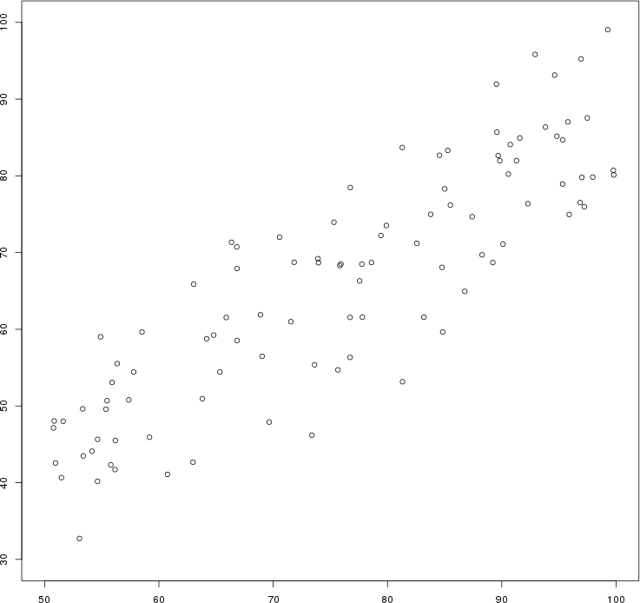
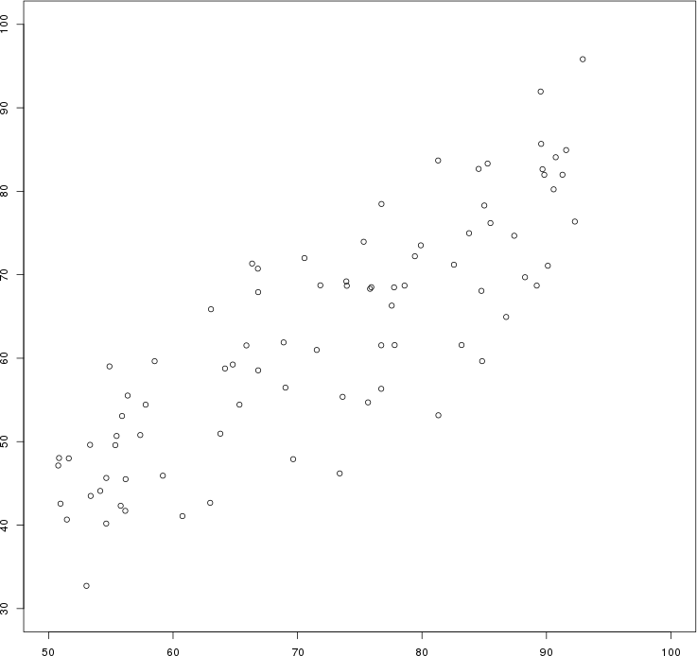
Artificial data: the $y$ values of all points for which $x>92$ have been erased by mistake.
Original Data
List-wise Deletion

Slide 12
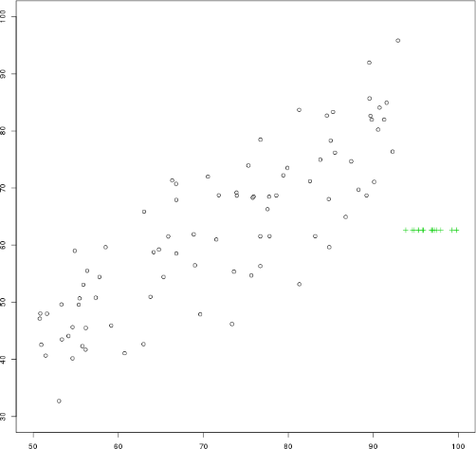
Artificial data: the $y$ values of all points for which $x>92$ have been erased by mistake.
Original Data
Mean Imputation

Slide 13
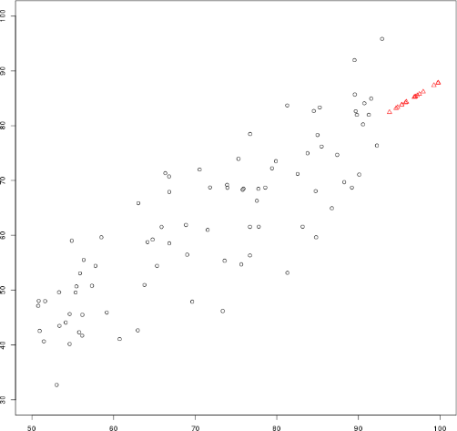
Artificial data: the $y$ values of all points for which $x>92$ have been erased by mistake.
Original Data
Regression Imputation

Slide 14
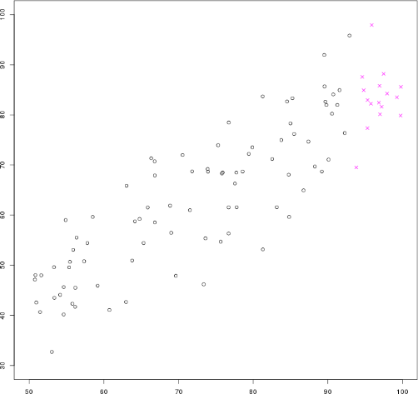
Artificial data: the $y$ values of all points for which $x>92$ have been erased by mistake.
Original Data
Stochastic Regression Imputation

Slide 15
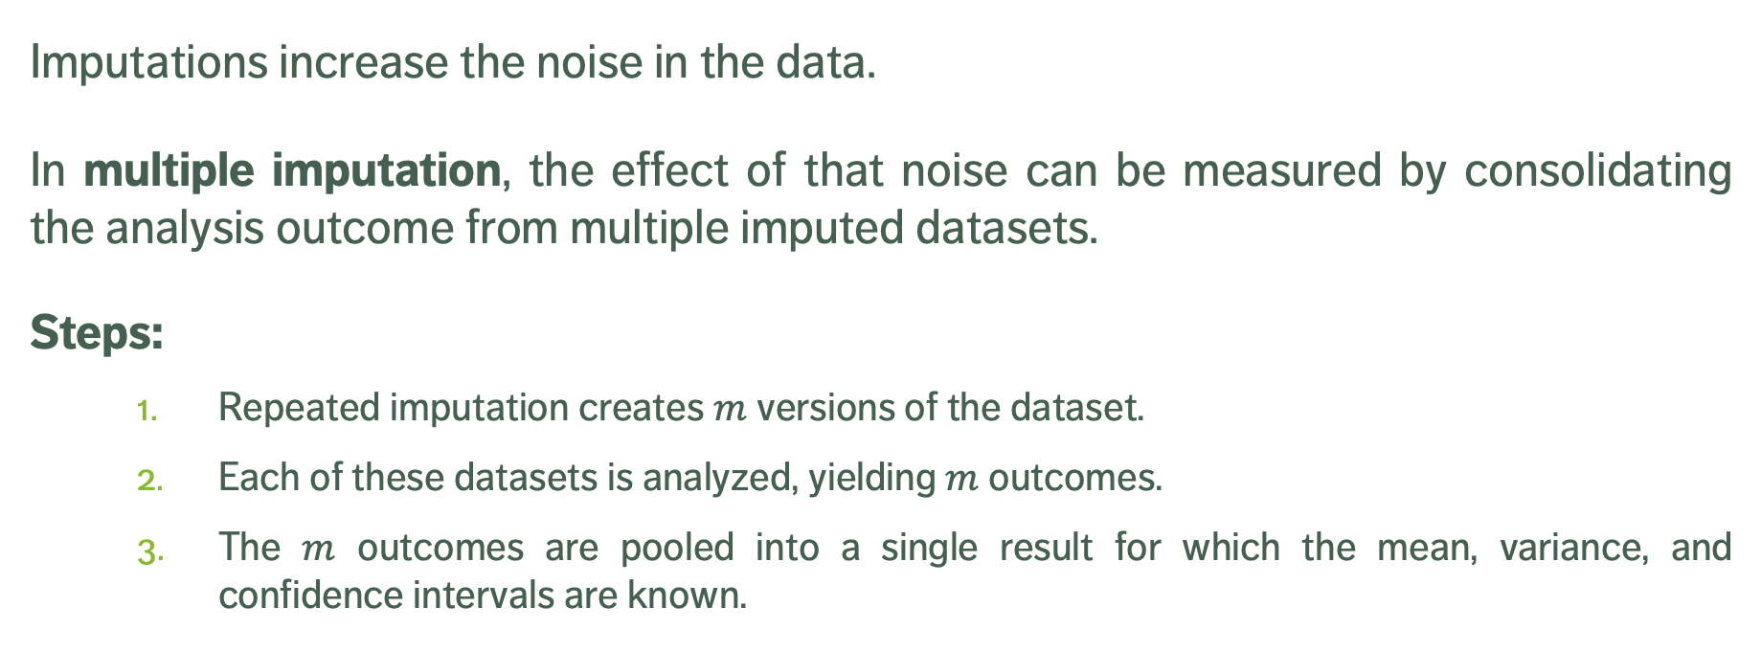
Multiple Imputation
Imputations increase the noise in the data.
In multiple imputation, the effect of that noise can be measured by consolidating the analysis outcome from multiple imputed datasets.
Steps:
Repeated imputation creates $m$ versions of the dataset.
Each of these datasets is analyzed, yielding $m$ outcomes.
The $m$ outcomes are pooled into a single result for which the mean, variance, and confidence intervals are known.

Slide 16
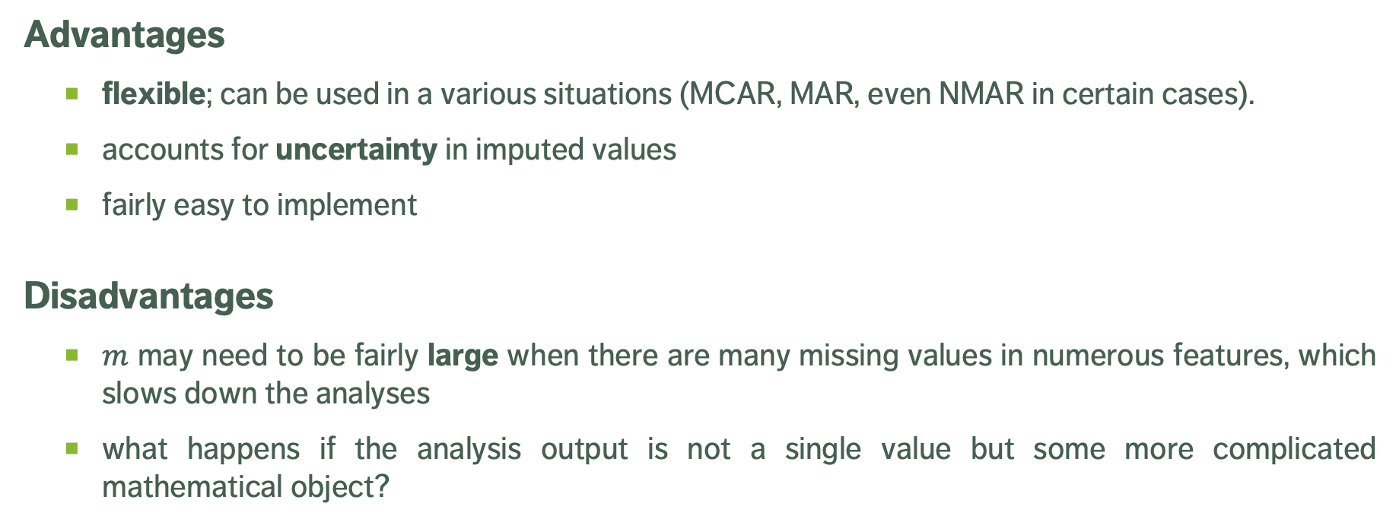
Multiple Imputation
Advantages
flexible; can be used in a various situations (MCAR, MAR, even NMAR in certain cases).
accounts for uncertainty in imputed values
fairly easy to implement
Disadvantages
$m$ may need to be fairly large when there are many missing values in numerous features, which slows down the analyses
what happens if the analysis output is not a single value but some more complicated mathematical object?

Slide 17
TAKE-AWAYS
Missing values cannot simply be ignored.
The missing mechanism cannot typically be determined with any certainty.
Imputation methods work best when values are missing completely at random or missing at random, but imputation methods tend to produce biased estimates.
In single imputation, imputed data is treated as the actual data; multiple imputation can help reduce the noise.
Is stochastic imputation best? In our example, yes – but beware the No-Free Lunch theorem!

Slide 18
Special Data Points
Outlying observations are data points which are atypical in comparison to
the unit's remaining features (within-unit),
the field measurements for other units (between-units),
or as part of a collective subset of observations.
Outliers are observations which are dissimilar to other cases or which contradict known dependencies or rules.
Careful study is needed to determine whether outliers should be retained or removed from the dataset.

Slide 19
Special Data Points
Influential data points are observations whose absence leads to markedly different analysis results.
When influential observations are identified, remedial measures (such as data transformations) may be required to minimize their undue effects.
Outliers may be influential data points, yet influential data points need not be outliers (weighted data).

Slide 20
Detecting Anomalies
Outliers may be anomalous along any of the unit’s variables, or in combination.
Anomalies are by definition infrequent, and typically shrouded in uncertainty due to small sample sizes.
Differentiating anomalies from noise or data entry errors is hard.
Boundaries between normal and deviating units may be fuzzy.
When anomalies are associated with malicious activities, they are typically disguised.

Slide 21
Detecting Anomalies
Numerous methods exist to identify anomalous observations; none of them are foolproof and judgement must be used.
Graphical methods are easy to implement and interpret.
Outlying Observations
box-plots, scatterplots, scatterplot matrices, 2D tour, Cooke's distance, normal qq plots
Influential Data
some level of analysis must be performed (leverage)
Once anomalous observations have been removed from the dataset, previously “regular" units may become anomalous.

Slide 22
Outlier Tests
Supervised methods use a historical record of labeled anomalous observations:
domain expertise required to tag the data
classification or regression task (probabilities and inspection rankings)
rare occurrence problem (more on this later)
Unsupervised methods don’t use external information:
traditional methods and tests
can also be seen as a clustering or association rules problem
Semi-supervised methods also exist.

Slide 23
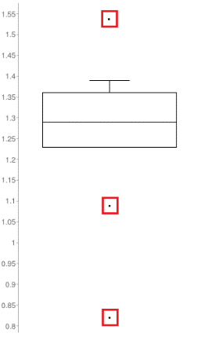
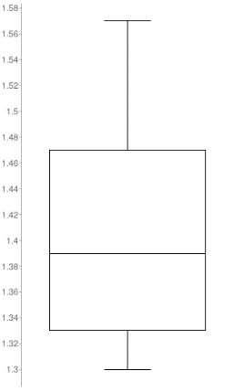
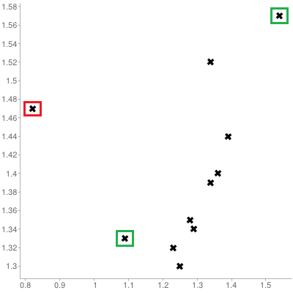
Illustration – Outliers
[Personal file]
Queuing dataset: processing rate vs. arrival rate

Slide 24
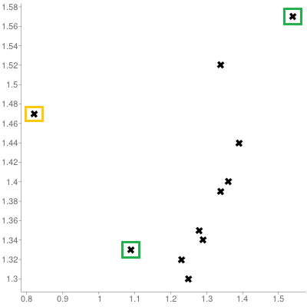
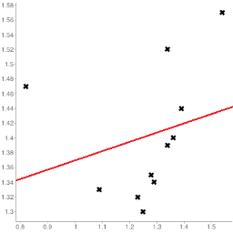
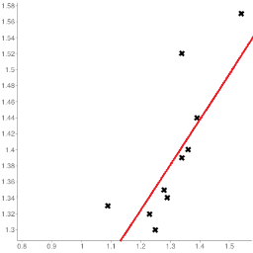
Illustration – Influential Observations
[Personal file]
Queuing dataset: processing rate vs. arrival rate
[Personal files]

Slide 25
TAKE-AWAYS
Identifying influential points is an iterative process as the various analyses have to be run numerous times.
Fully automated identification and removal of anomalous observations is NOT recommended.
Use transformations if the data is NOT normally distributed.
Whether an observation is an outlier or not depends on various factors; what observations end up being influential data points depends on the specific analysis to be performed.

Slide 26
EXERCISES
The ability to monitor and perform early forecasts of various river algae blooms is crucial to control any ecological harm they can cause.
The algae_bloom.csv dataset is used to train a learning model consists of:
chemical properties of various water samples of European rivers
the quantity of seven algae in each of the samples, and
the characteristics of the collection process for each sample.
What is the data science motivation for such a model, given that we can actually analyze water samples to determine if various harmful algae are present or absent?

Slide 27
EXERCISES
The answer is simple: chemical monitoring is cheap and easy to automate, whereas biological analysis of samples is expensive and slow.
Another answer is that analyzing the samples for harmful content does not provide a better understanding of algae bloom drivers: it just tells us which samples contain the harmful algaes.
Can our model provide a more thorough understanding of the algae situation?

Slide 28
EXERCISES
Locate and determine the structure of the algae bloom dataset, and provide a summary of its features.
Compute the number of missing values for each record.
Identify some potential anomalous observations in the same dataset.
What strategies could you use to deal with such observations / records?

Slide 29
Supplemental Material

Slide 30
Pros and Cons
Methodical (syntax)
Pros: checklist is context-independent; pipelines easy to implement; common errors and invalid observations easily identified
Cons: may prove time-consuming; cannot identify new types of errors
Narrative (semantics)
Pros: process may simultaneously yield data understanding; false starts are (at most) as costly as switching to mechanical approach
Cons: may miss important sources of errors and invalid observations for datasets with high number of features; domain knowledge may bias the process by neglecting uninteresting areas of the dataset

Slide 31
Tools and Methods
Methodical
list of potential problems (Data Cleaning Bingo)
code which can be re-used in different contexts
Narrative
visualization
data summary
distribution tables
small multiples
data analysis

Slide 32
Data Cleaning Bingo

Slide 33
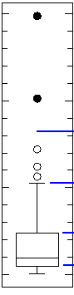
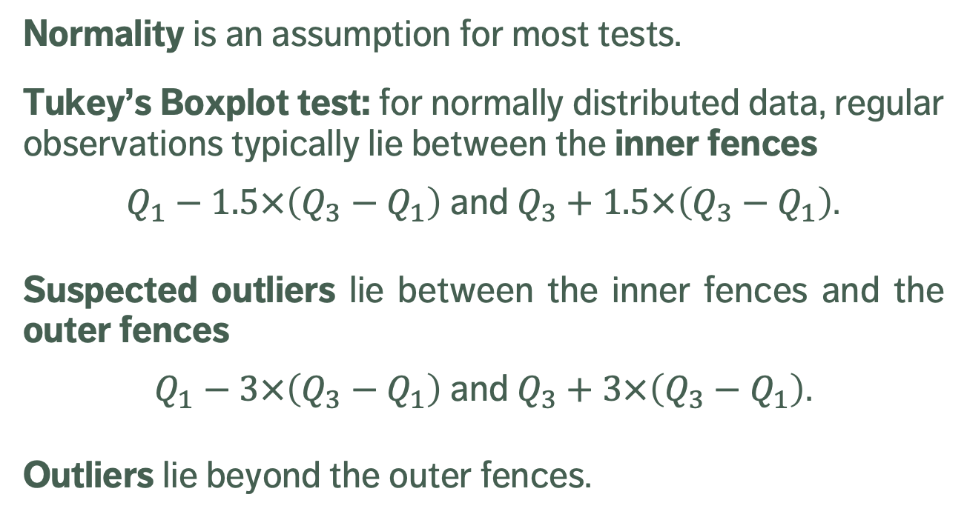
Outlier Tests
Normality is an assumption for most tests.
Tukey’s Boxplot test: for normally distributed data, regular observations typically lie between the inner fences
$Q_{1}−1.5×\left(Q_{3}−Q_{1}\right)$ and $Q_{3}+1.5×\left(Q_{3}−Q_{1}\right)$.
Suspected outliers lie between the inner fences and the outer fences
$Q_{1}−3×\left(Q_{3}−Q_{1}\right)$ and $Q_{3}+3×\left(Q_{3}−Q_{1}\right)$.
Outliers lie beyond the outer fences.
outliers
outer fence
suspected
outliers
inner fence
regular
points

Slide 34
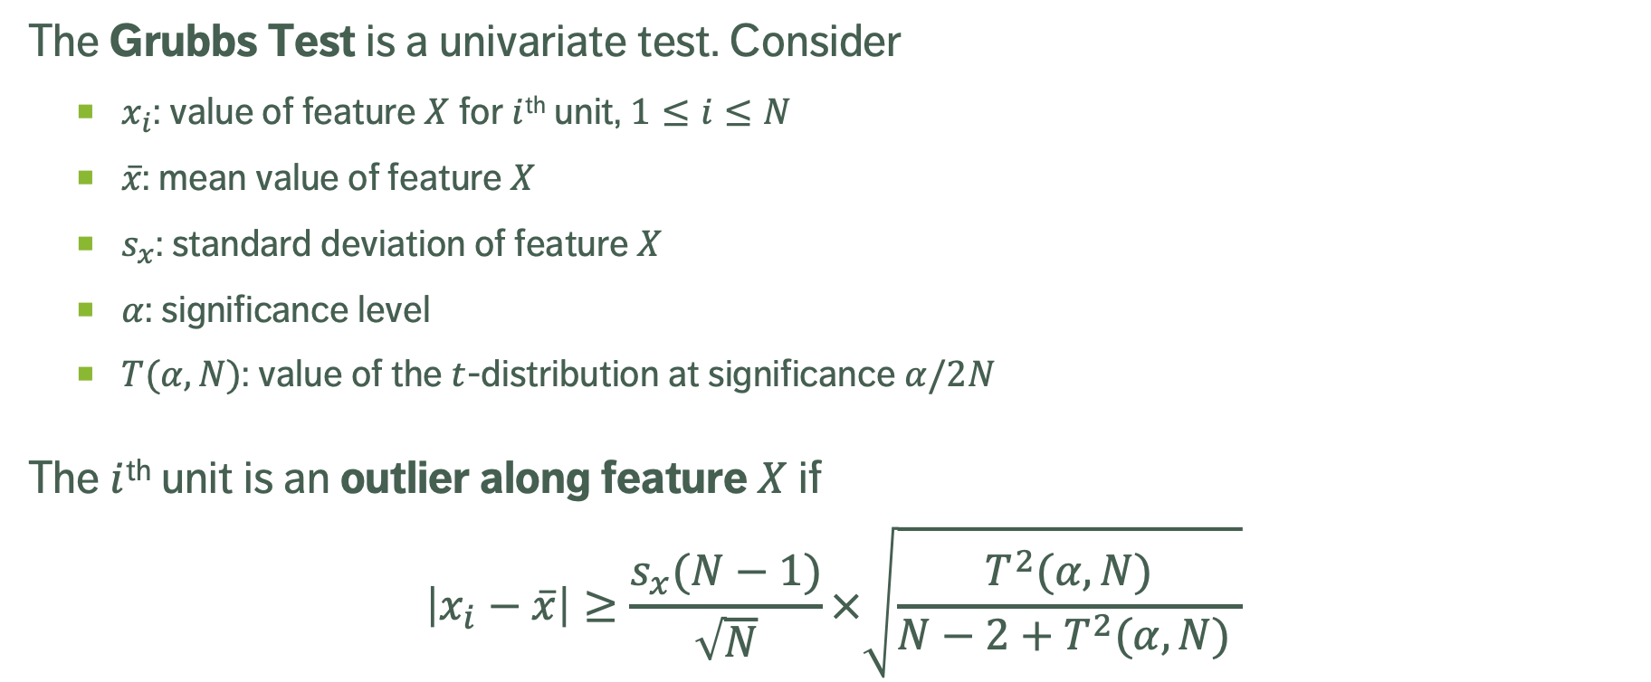
Outlier Tests
The Grubbs Test is a univariate test. Consider
$x_{i}$: value of feature $X$ for $i$^{th} unit, $1≤i≤N$
$\overline{x}$: mean value of feature $X$
$s_{x}$: standard deviation of feature $X$
$α$: significance level
$T(α,N)$: value of the $t$-distribution at significance $α/2N$
The $i$^{th} unit is an outlier along feature $X$ if
$$\left|x_{i}−\overline{x}\right|≥\frac{s_{x}(N−1)}{\sqrt{N}}×\sqrt{\frac{T^{2}(α,N)}{N−2+T^{2}(α,N) }}$$

Slide 35
Outlier Tests
The Dixon Q Test is used in experimental sciences to find outliers in (extremely) small datasets (dubious validity).
The Mahalanobis Distance (linked to the leverage) can be used to find multi-dimensional outliers (when relationships are linear).
Other tests:
Tietjen-Moore (for a specific # of outliers)
generalized extreme studentized deviate (for unknown # of outliers)
chi-square (outliers affecting goodness-of-fit)
DBSCAN, OR_{h} and LOF (unsupervised outlier detection)

Slide 36
Imputation Methods
List-wise deletion: remove units with at least one missing values.
Assumption: MCAR
Cons: can introduce bias (if not MCAR), reduction in sample size, increase in standard error
Mean or Most Frequent Imputation: substitute missing values by average value or most frequent value
Assumption: MCAR
Cons: distortions of distribution (spike at mean) and relationships among variables

Slide 37
Imputation Methods
Regression or Correlation Imputation: substitute missing values by using regression based on other variables (with complete information)
Assumption: MAR
Cons: artificial reduction in variability, over-estimation of correlation
Stochastic Regression Imputation: regression imputation with random error terms added
Assumption: MAR
Cons: increased risk of type I error (false positives) due to small std error

Slide 38
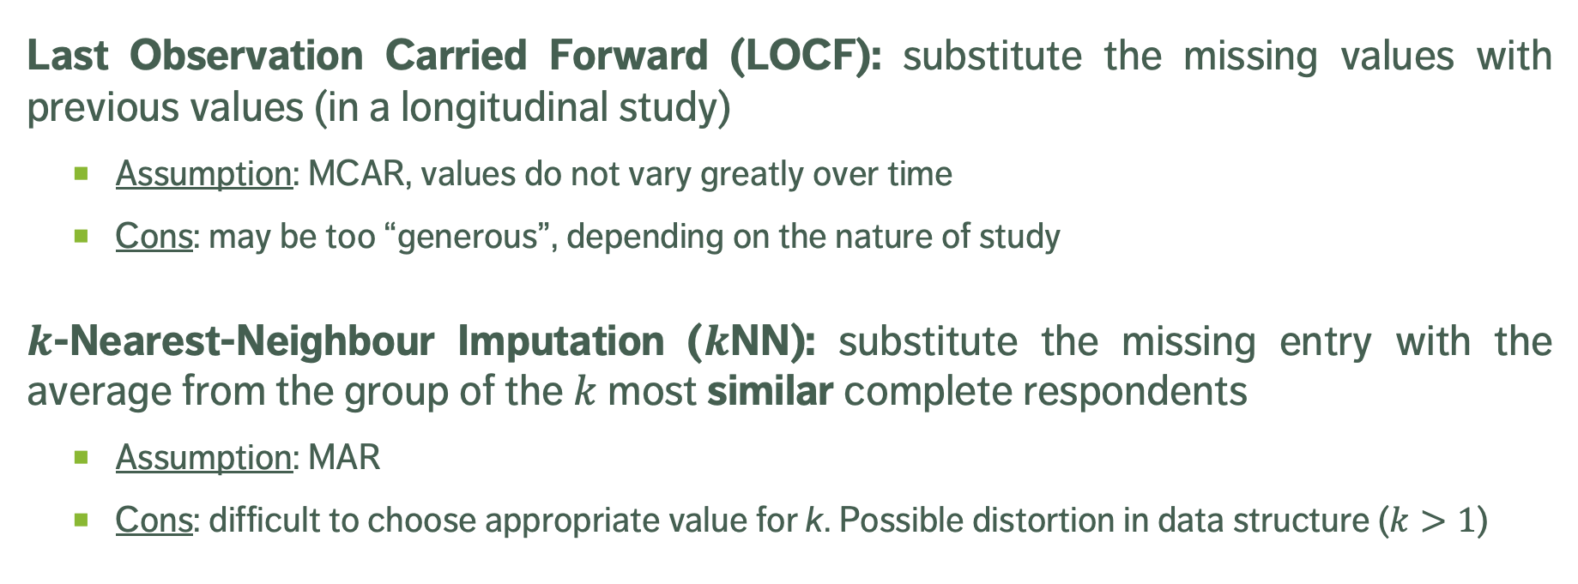
Imputation Methods
Last Observation Carried Forward (LOCF): substitute the missing values with previous values (in a longitudinal study)
Assumption: MCAR, values do not vary greatly over time
Cons: may be too “generous”, depending on the nature of study
$k$-Nearest-Neighbour Imputation ($k$NN): substitute the missing entry with the average from the group of the $k$ most similar complete respondents
Assumption: MAR
Cons: difficult to choose appropriate value for k. Possible distortion in data structure ($k>1$)

